Slide 1
04
Session 4 of 24
Uncertainty, samples and cause
How sure can we be, and when does a pattern mean one thing caused another?
Jotham Martin Wambi, KLAi Professional Learning
Session 4 Uncertainty, samples and cause
1
Notes:
So far we've described the data we hold. Today we ask how sure we can be. If you look at thirty orders, how far can their average sit from the truth? We'll find out by simulating it in Google Sheets, with no code at all. We'll also look at correlation, at why two things that move together may have nothing to do with each other, and at the ways a sample can quietly mislead you. By the end you'll have built two hundred samples yourself and watched the spread appear.

Slide 2
By the end of today
How the two hours run
Explain why a sample differs from the whole.
Recall and warm-up
10 min
Concepts and explanation
30 min
Read a correlation and say what it does not show.
Live demonstration
25 min
Break
5 min
Name two sources of bias.
Guided lab
40 min
Check and wrap-up
10 min
Session 4 Uncertainty, samples and cause
2
Notes:
The simulation is the centre of today. I build it live in Sheets, and then you run it yourself for forty minutes. By the end you'll explain why a sample differs from the whole file, and how a bigger sample narrows that gap. You'll read a correlation and say what it does not show. And you'll name two sources of bias, selection and survivorship. There's no code today. Every formula is one you can type into a cell.

Slide 3
Vocabulary
Word | Plain meaning | In a spreadsheet
Probability | The share you get over many tries. | COUNTIF divided by rows
Sample | A few rows from the whole file. | 30 rows of 2,000
Sampling error | The gap between a sample and the whole. | Two AVERAGEs that differ
Simulation | Many random draws done by computer. | RANDBETWEEN filled down
Correlation | A number from -1 to 1 for two columns moving together. | CORREL
Confounder | A hidden factor that drives two things. | A column never added
Selection bias | Rows chosen by something other than chance. | A forgotten filter
Survivorship bias | Studying only what stayed. | Deleted failed rows
Session 4 Uncertainty, samples and cause
3
Notes:
Here are the eight words for today, each with a spreadsheet cousin. Probability is a share that settles down over many tries, like a COUNTIF divided by the row count. A sample is a few rows from the whole file. Sampling error is the gap between the two. A simulation is a fill down of random picks. Correlation is the number CORREL gives you. A confounder is a hidden column you never added. Selection bias is a filter you didn't choose. Survivorship bias is a table where the failures were deleted. Each one is a formula or a habit you could already use in Sheets.

Slide 4
Warm-up from Session 3
1
A few very large orders sit in your column. Mean or median for a typical order, and why?
The median. Big orders pull the mean up: 47,491 against 23,200 UGX.
2
A bar chart makes a small gap look huge. What do you check first?
Whether the axis starts at zero.
Session 4 Uncertainty, samples and cause
4
Notes:
Let's recall the mean, the median and the cut axis from Session 3.
First. A few very large orders sit in your column. Which do you report for a typical order, the mean or the median, and why? Have a think.
The median. A few huge orders pull the mean up. At Lakeside Mart the mean is forty seven thousand four hundred and ninety one shillings and the median is twenty three thousand two hundred. The median describes the order most customers actually place.
Second. A bar chart makes a small difference look enormous. What do you check first? No rush.
Whether the axis starts at zero. A cut axis stretches small gaps. Today we ask a harder question about numbers like these. How much can they wobble just because of which rows we happened to look at?

Slide 5
Probability is the share you get over many tries
Count the large orders in the 2,000 order workbook. Then count them in the full file.
In the workbook
139 of 2,000 orders are above 100,000 UGX. That is 6.95 percent.
In the full file
2,214 of 30,229 orders are above 100,000 UGX. That is 7.32 percent.
The long run
The more orders you count, the more steadily the share settles.
One order
The share cannot say if the next order is large. It speaks for many.
Session 4 Uncertainty, samples and cause
5
Notes:
Let's start with probability, in plain words. Probability is the share you get when you repeat something many times.
Let's count one. In the workbook you'll use today there are two thousand orders. COUNTIF finds how many are above a hundred thousand shillings. It's a hundred and thirty nine. Divide by two thousand and you get six point nine five percent.
Now look at the full file of thirty thousand two hundred and twenty nine orders. There the share is seven point three two percent. The more orders you count, the more steadily the share settles. Statisticians call that the long run.
A share can't tell you whether the next order will be large. It describes what happens over many orders.

Slide 6
The Sheets formulas for a simulation
Job | Formula | What you get
A random decimal | =RAND() | A number from 0 to 1, new on every recalculation
A random row number | =RANDBETWEEN(1,2000) | A whole number from 1 to 2000
One random order | =INDEX(orders!$G$2:$G$2001, RANDBETWEEN(1,2000)) | The order value in that random row
A sample of 30 | Fill that formula across A2:AD2 | Thirty random orders in one row
The sample mean | =AVERAGE(A2:AD2) | One mean for the row
Share of the sample above 100,000 | =COUNTIF(A2:AD2,">100000")/30 | One share for the row
Fill the row down 200 times to get 200 samples.
Session 4 Uncertainty, samples and cause
6
Notes:
Here are the formulas for the whole simulation. Each one is short.
RAND gives a random decimal between zero and one. It changes every time the sheet recalculates. RANDBETWEEN gives a random whole number between two limits we choose. Here we choose one and two thousand, so it picks a row number.
The third row joins them. INDEX looks into the order values and returns the one in that random row. That's one random order. Fill the formula across thirty cells and you have a sample of thirty. AVERAGE gives its mean, and COUNTIF with a hundred thousand tells you what share of the thirty are large.
Only RANDBETWEEN and INDEX are new to you. We'll build it together in a minute.

Slide 7
Build 200 samples of 30 in five steps
Pick
Fill right
Average
Fill down
Chart
One random order in A2 with INDEX and RANDBETWEEN
Drag to AD2 for thirty orders
AE2 is =AVERAGE(A2:AD2)
Down to row 201 for 200 samples
A histogram of column AE
Freeze the numbers before you chart them.
Session 4 Uncertainty, samples and cause
7
Notes:
Building two hundred samples takes five steps, and you'll repeat them in the lab.
First, pick one random order. In cell A2 on a new sheet, type the INDEX formula with RANDBETWEEN inside it. One cell, one random order.
Second, fill right. Drag the cell across to column AD and you have thirty random orders in a single row. That row is one sample.
Third, average it. In AE2 type AVERAGE of A2 to AD2. That's the sample mean.
Fourth, fill down. Select the whole row and drag down to row two hundred and one. Now you have two hundred samples and two hundred means.
Fifth, chart column AE as a histogram, the same chart you made in Session 3. Before you chart it, freeze the numbers. I'll show you why in a moment.

Slide 8
Sampling error
The gap between what a sample shows and what the whole file shows, caused only by which rows were drawn.
In our data
In a spreadsheet
The workbook holds 2,000 orders with a mean of 49,931 UGX. The full file of 30,229 orders has 47,491. The gap of about 2,439 UGX is sampling error.
The gap between AVERAGE of the rows you picked and AVERAGE of the whole column.
Session 4 Uncertainty, samples and cause
8
Notes:
One term to fix in your mind. Sampling error.
In plain words, it's the gap between what a sample shows and what the whole file would show, caused only by which rows happened to be drawn. Nobody made a mistake.
Our workbook is itself a sample of two thousand orders from the thirty thousand. Its mean is forty nine thousand nine hundred and thirty one shillings. The full file's mean is forty seven thousand four hundred and ninety one. The gap, about two thousand four hundred and thirty nine shillings, is sampling error.
In Sheets it's the gap between the AVERAGE of the rows you picked and the AVERAGE of the whole column. Same formula, different rows, different answer.

Slide 9
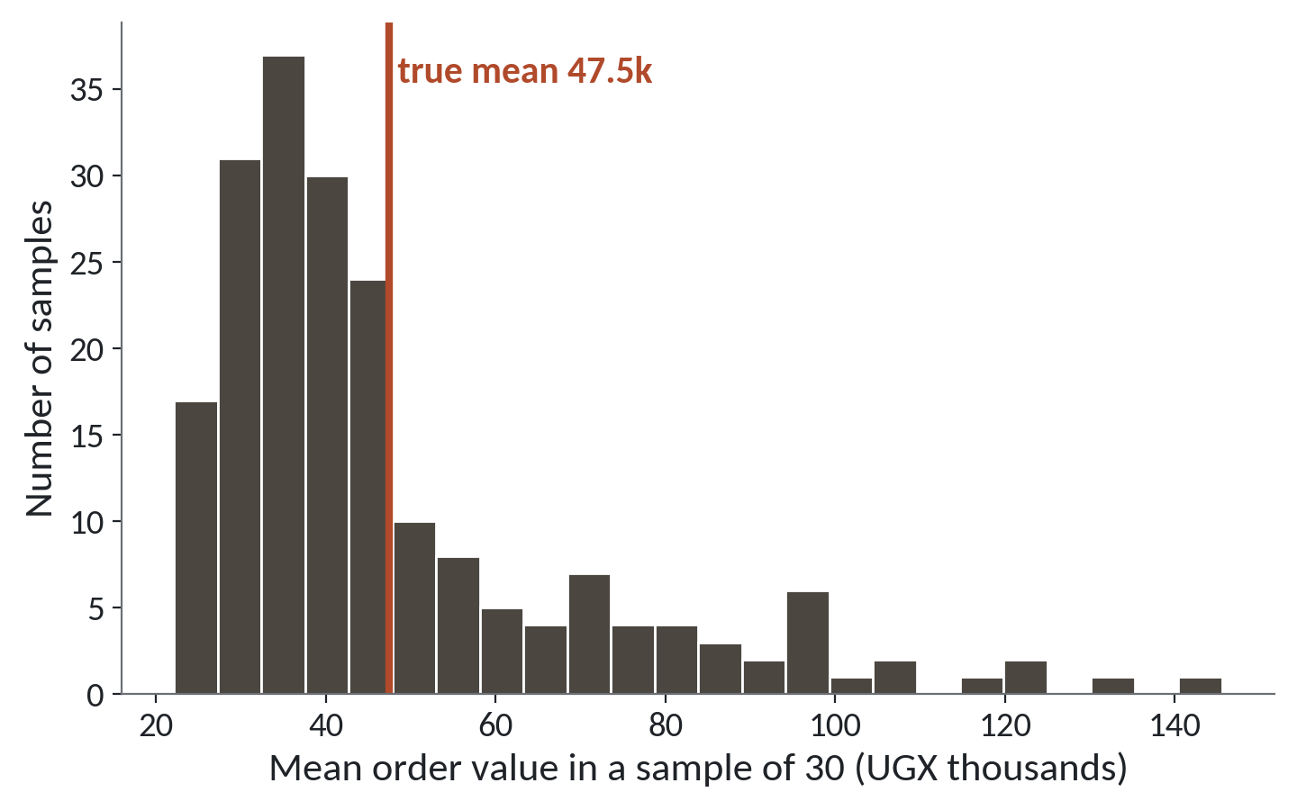
200 samples of 30 orders give 200 different means
1
The means run from about 22,000 to 146,000 UGX.
2
139 of the 200 samples fall below the true mean of 47,491.
3
A long tail to the right, the skew from Session 3.
Each bar counts samples. The red line is the mean of the full file.
Session 4 Uncertainty, samples and cause
9
Notes:
Two hundred samples look like this. Each one is thirty random orders from the full file, and each gives one mean. This chart counts those means.
Start with the spread across the bottom. The means run from about twenty two thousand to about a hundred and forty six thousand. Same file, same method, and the answers differ that much.
Now the red line, the true mean of forty seven thousand four hundred and ninety one. A hundred and thirty nine of the two hundred samples fall below it. A typical sample of thirty tends to miss the biggest orders.
The bars lean to the left and a long tail runs to the right. That's the same skew you met in Session 3. When a few big orders land in a sample, they drag its mean far to the right.

Slide 10
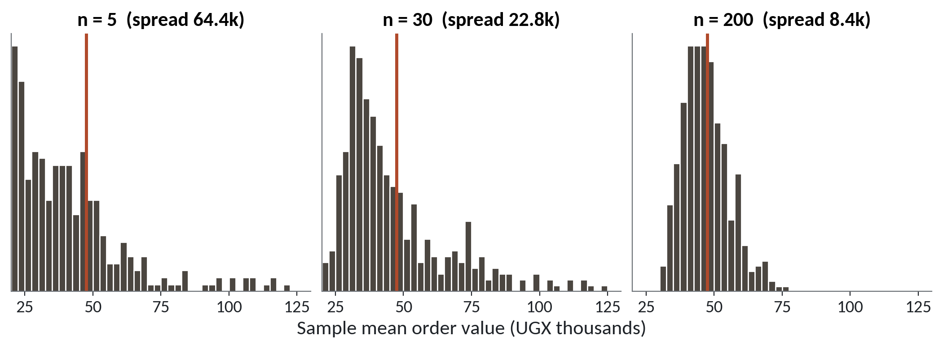
A bigger sample narrows the spread
1
n = 5: spread 64.4k. The means are all over the place.
2
n = 30: spread 22.8k.
3
n = 200: spread 8.4k. The bars bunch round the true mean.
Spread is the standard deviation of the sample means, in UGX thousands.
Session 4 Uncertainty, samples and cause
10
Notes:
Now the question everyone asks. Does a bigger sample help? Three panels, same file, three sample sizes. Each panel shows four hundred sample means, and the red line is the true mean.
With five orders in a sample, the spread is sixty four thousand four hundred shillings. That's the standard deviation of the sample means, the same spread measure from Session 3. The means are all over the place.
With thirty orders it drops to twenty two thousand eight hundred.
With two hundred orders it's eight thousand four hundred, and the bars bunch around the red line.
A bigger sample narrows the spread, though each gain costs more. Going from five to thirty cuts the spread by about two thirds, and that takes twenty five more orders. Going from thirty to two hundred cuts it by about two thirds again, and that takes a hundred and seventy more.

Slide 11
Your simulation changes every time you touch the sheet
What it looks like
Why it goes wrong
The fix
You build 200 samples and note the spread. Then you type in any cell, and every number in the grid changes.
RAND and RANDBETWEEN recalculate on every edit. The sheet never remembers the draw.
Copy the block, then Paste special, Values only. Report numbers from the frozen copy.
Session 4 Uncertainty, samples and cause
11
Notes:
You'll meet this trap in the lab, and it gives you no error at all.
You build your two hundred samples and read off the spread. Then you type a note in any cell, and every number in the grid changes. Your chart no longer matches what you wrote down.
The reason is that RAND and RANDBETWEEN recalculate whenever the sheet changes. The sheet doesn't remember the draw. It makes a fresh one each time.
The fix is to freeze. Select the block, copy it, then use Paste special and choose Values only. The formulas turn into plain numbers that stay put. Do this before you chart, and write down your results from the frozen copy.

Slide 12
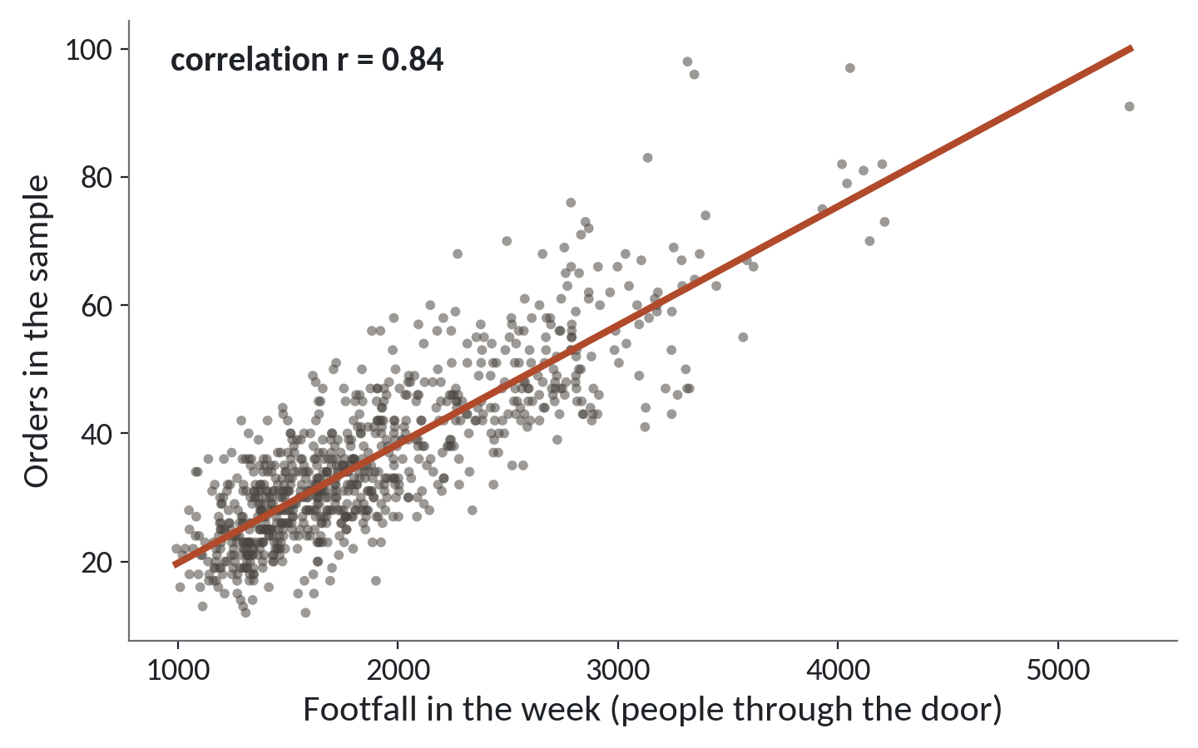
Busy weeks have more orders
1
Each dot is one branch in one week. There are 832.
2
The dots climb. More people through the door, more orders.
3
The correlation r is 0.84.
Footfall is the door counter. Orders are the orders recorded that week.
Session 4 Uncertainty, samples and cause
12
Notes:
Two columns at once now. It's the weekly branch file. Across the bottom is footfall, the door counter. Up the side is the number of orders recorded that week.
Each dot is one branch in one week. There are eight hundred and thirty two of them.
The dots climb from lower left to upper right. Weeks with more people through the door tend to have more orders. The red line is the trendline you can add to any Sheets scatter chart.
The number in the corner, r equals zero point eight four, is the correlation. We define it next. Zero point eight four is a strong link.

Slide 13
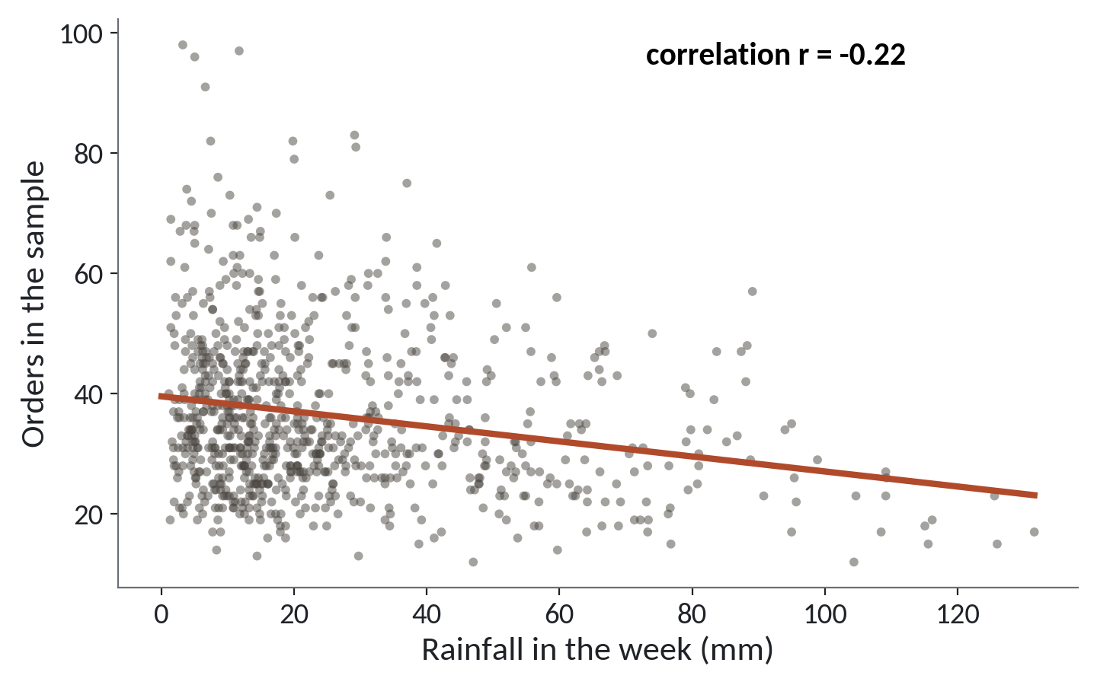
Wetter weeks have fewer orders, with a lot of scatter
1
The line slopes gently down.
2
The correlation r is minus 0.22, a weak link.
3
Dry weeks run from very few orders to very many.
Same 832 branch weeks, now against rainfall in millimetres.
Session 4 Uncertainty, samples and cause
13
Notes:
Now the same weeks against rainfall.
The red line slopes gently down. Wetter weeks tend to have fewer orders.
The correlation is minus zero point two two. That's a weak link, and the picture shows why. The dots form a wide cloud around the line.
The dry weeks on the left vary a lot. Some have very few orders and some have very many. Rain alone can't predict a week's orders. In Session 13 you'll learn to weigh footfall and rain together.

Slide 14
Correlation
One number from minus 1 to plus 1 that says how closely two columns rise and fall together.
In our data
In a spreadsheet
Footfall and orders give 0.84. Rainfall and orders give minus 0.22. Zero means no straight line link.
=CORREL(C2:C833, F2:F833) on the branch_weeks sheet, where C is footfall and F is orders.
Session 4 Uncertainty, samples and cause
14
Notes:
Time for the word. Correlation. In plain words, it's one number between minus one and plus one that says how closely two columns rise and fall together.
Plus one means they climb in perfect step. Minus one means one rises exactly as the other falls. Zero means no straight line link at all.
Footfall and orders give zero point eight four. Rainfall and orders give minus zero point two two.
In Sheets you already have it. CORREL, with the two columns inside the brackets. On the branch weeks sheet, footfall is column C and orders is column F.

Slide 15
What a correlation does not show
A correlation summarises a picture, and a summary leaves things out.
Cause
Two columns can move together while neither pushes the other.
Size
0.84 says the dots hug the line. It does not say how many orders 1,000 more visitors bring.
Shape
It measures straight line links only. Draw the scatter before you trust the number.
Session 4 Uncertainty, samples and cause
15
Notes:
A correlation is a summary of a picture, and a summary leaves things out. Three limits to keep with you.
First, cause. Two columns can move together while neither one pushes the other. We look at that next.
Second, size. Zero point eight four says the dots hug the line. It doesn't tell you how many extra orders a thousand more visitors would bring. That's how steeply the line climbs, and it's a different question.
Third, shape. Correlation only measures straight line links. A curve can have a correlation near zero. So draw the scatter first, then read the number.

Slide 16
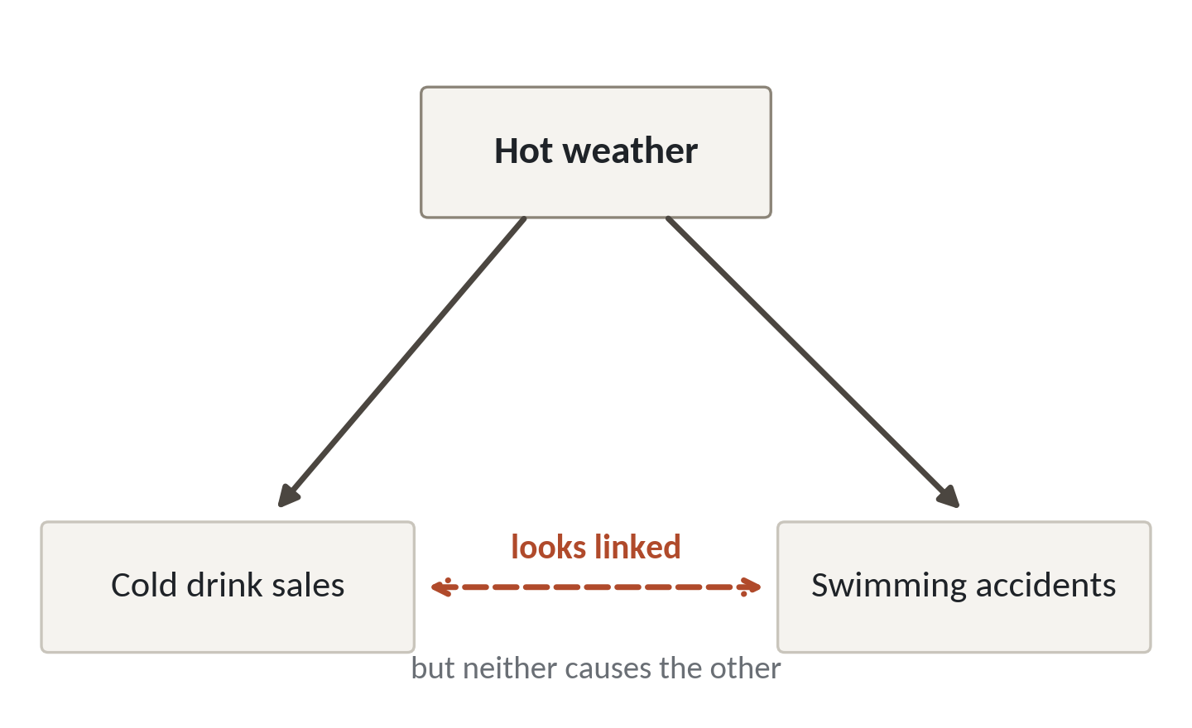
A hidden third factor can link two things that never touch
1
Hot weather lifts cold drink sales.
2
Hot weather also sends more people swimming, so accidents rise.
3
Drinks and accidents look linked. Neither causes the other.
The hidden factor is called a confounder.
Session 4 Uncertainty, samples and cause
16
Notes:
This picture matters most today. Hot weather sits at the top. Two things sit below it, cold drink sales and swimming accidents.
Hot weather lifts cold drink sales. More people buy a cold drink when it's hot.
Hot weather also puts more people in the water, so swimming accidents rise too.
Now look at the dashed line between the two boxes at the bottom. Drink sales and accidents rise together, so their correlation is high. Yet a cold drink never pushed anyone into a lake. The hidden factor above them drives both. That hidden factor has a name. It's called a confounder.

Slide 17
Branch size lifts both footfall and orders
Branch | Average weekly footfall | Average weekly orders | Correlation inside the branch
Kampala Central | 2,958 | 56.6 | 0.70
Kampala Ntinda | 2,433 | 46.4 | 0.55
Entebbe | 1,683 | 32.2 | 0.53
Jinja | 1,852 | 34.2 | 0.57
Mbale | 1,505 | 29.2 | 0.71
Mbarara | 1,914 | 37.0 | 0.66
Fort Portal | 1,310 | 26.8 | 0.73
Gulu | 1,489 | 28.2 | 0.55
All 832 weeks together: r = 0.84. Inside one branch: 0.53 to 0.73.
Session 4 Uncertainty, samples and cause
17
Notes:
Our own data has a confounder too. Branch size.
The middle columns show each branch's average weekly footfall and average weekly orders. Kampala Central is the biggest. Almost three thousand people a week, and about fifty seven orders a week. Fort Portal is the smallest, with about thirteen hundred people and under twenty seven orders. Big branches have more of both.
Line up the eight branch averages and the correlation is nearly perfect, zero point nine nine seven. Much of that comes from branch size pushing both columns up together.
The last column is the check. Take one branch at a time and the correlation falls to between zero point five three and zero point seven three. The link is still real, and it's weaker than the zero point eight four we saw when we pooled every branch.

Slide 18
Reading a correlation as a lever
What it looks like
Why it goes wrong
The fix
Footfall and orders correlate at 0.84. So you pay for flyers to lift footfall and expect orders to follow.
The 0.84 mixes two things. Big branches have more of both, and busy weeks inside a branch have more of both. Flyers change neither.
Compare inside one branch, name the hidden factors, and test the change small before you spend.
Session 4 Uncertainty, samples and cause
18
Notes:
This trap costs real money.
You see that footfall and orders correlate at zero point eight four. So you pay for flyers to push footfall up, and you expect orders to follow.
The zero point eight four mixes two things. Big branches have more of both. And busy weeks inside one branch also have more of both. Flyers change neither of those. The pooled number overstates what a change at one branch would bring.
The fix is to compare inside one branch, name the hidden factors you can think of, and test the change on a small scale before you spend. In Session 12 we'll learn how to run that test properly.

Slide 19
Two ways a sample misleads you
Selection bias
Survivorship bias
Something other than chance chose the rows
You see only what stayed
Example: only customers who gave a loyalty number
Example: studying only branches still open
Fix: compare your rows with the missing rows
Fix: ask who or what is missing, and why
Before you trust a sample, ask how each row got into it.
Session 4 Uncertainty, samples and cause
19
Notes:
Two ways a sample misleads you. Neither one shows up as an error.
On the left, selection bias. Something other than chance decided which rows you see. Say you study only customers who gave a loyalty number. The walk in customers have gone missing from your table. The fix is to compare the rows you have with the rows you don't.
On the right, survivorship bias. You only see what stayed. Think of studying only the branches that are still open. The ones that closed can't speak. A well known story from the Second World War is told about the statistician Abraham Wald. The military studied the bullet holes on bombers that came back, and the obvious idea was to armour those spots. Wald's point was that the planes that never returned had been hit elsewhere, so the places with no holes were the ones to protect. The fix is to ask who or what is missing, and why.
Before you trust a sample, ask how each row got into it.

Slide 20
Checking our own data for bias
47,432
Mean order value, loyalty orders (70% of all orders)
47,628
Mean order value, walk in orders
8.43
Orders per customer, all 2,499 customers
8.70
Orders per customer, the 2,224 still ordering in late 2025
Both gaps are small, so the bias is mild here. You only know after you check.
Session 4 Uncertainty, samples and cause
20
Notes:
Let's check our own data for bias, with numbers from the full file.
About seventy percent of orders carry a loyalty number, twenty one thousand and fifty eight of the thirty thousand two hundred and twenty nine. If we looked only at those, would we get a different picture of order value? The mean is forty seven thousand four hundred and thirty two shillings for loyalty orders and forty seven thousand six hundred and twenty eight for walk in orders. Almost identical.
Now the survivors. Of the two thousand four hundred and ninety nine customers with orders, two thousand two hundred and twenty four still ordered from July twenty twenty five onward. Those still ordering average eight point seven orders each, against eight point four three for everyone. A small gap.
Both gaps are small, so the bias is mild here. You only know that because you checked. Make the check a habit.

Slide 21
Lab: 200 samples and a confounding trap
1
Open lakeside_for_sheets.xlsx and find the mean of all 2,000 orders
Tool and time
Google Sheets
40 minutes
2
Build 200 samples of 30 orders and average each one
3
Freeze the numbers, then find the mean, spread, smallest, largest and count below 47,491
You are done when
4
Draw a histogram, then repeat with samples of 5
Your numbers fall inside the ranges on the lab sheet, and you can say why they differ from your neighbour's.
5
Find CORREL for footfall and for rainfall, then for one branch
6
Compare loyalty and walk in order values
7
Write three sentences on the confounding trap
Session 4 Uncertainty, samples and cause
21
Notes:
The first task is quick. Open the Lakeside workbook, find the mean of all two thousand orders, and compare it with the full file mean of forty seven thousand four hundred and ninety one. Forty minutes in Google Sheets, and no code.
Then build your two hundred samples of thirty. Freeze them before you do anything else. Once they're frozen, find the average, the spread, the smallest and the largest of your two hundred means, and draw the histogram. Repeat with just the first five columns to see the spread widen.
After that, calculate the two correlations, and one more for a single branch. Then compare the order values of loyalty customers and walk in customers, which is the bias check we just did on the full file.
The last step is three sentences about the confounding trap. Your numbers will differ from your neighbour's, and that's expected. The lab sheet gives ranges so you can see whether yours are sensible.

Slide 22
Questions to finish
1
Your sample of 30 orders has a mean of 41,000 UGX. The full file says 47,491. Has someone made a mistake?
No. That gap is sampling error. Another sample would differ, and a bigger one would land closer.
2
Footfall and orders have r = 0.84. Does that show more visitors cause more orders?
It shows they move together. Branch size and other hidden factors lie behind part of it. Test a change before you act.
3
You study only customers who stayed two years. What bias is that, and what do you ask?
Survivorship bias. Ask who left and how they differ.
Session 4 Uncertainty, samples and cause
22
Notes:
Let's check the ideas from today against some realistic cases. Your sample of thirty orders has a mean of forty one thousand shillings, and the full file says forty seven thousand four hundred and ninety one. Has someone made a mistake? Think it over.
No. That gap is sampling error. Another sample of thirty would give another mean, and a bigger sample would land closer.
Next, footfall and orders have a correlation of zero point eight four. Does that show more visitors cause more orders? Give that a moment.
It shows they move together. Branch size and other hidden factors lie behind part of that, so test a change before you act on it.
Last, you study only the customers who stayed with Lakeside for two years. What bias is that, and what do you ask? Sit with it for a second.
Survivorship bias. Ask who left, and how they differ from the ones who stayed.

Slide 23
Summary
A sample differs from the whole by chance alone, and a bigger sample narrows the gap.
A correlation shows two columns moving together. It does not show cause or size.
Ask how rows got into a sample, who is missing, and what hidden factor drives both columns.
Next session. Your first Python, next to the spreadsheet
Session 4 Uncertainty, samples and cause
23
Notes:
One. A sample differs from the whole file by chance alone. A bigger sample narrows the gap, and a simulation in Sheets lets you see it happen.
Two. A correlation shows two columns moving together. It says nothing about cause, and nothing about how much one changes when the other does.
Three. Before you trust a sample, ask how the rows got in, who is missing, and what hidden factor could drive both columns.
That finishes the first module, thinking with data. Next session we meet Python for the first time. Much of what you did today with INDEX and AVERAGE will have a Python twin, and we'll put them side by side.

